Slide 1

Machine Learning Lab
Final Project (Batch- 13)
Faculty: Dr. P Kuppuswamy

Slide 2
KDDCUp 1999 dataset
Apply Random Forest, Logistic Regression, Neural Network and KNN Classifier
Team Members,
Amara Santosh Jayanth –19BCN7136
Kota Sai Lakshmi – 19MIS7041
Venkata Abhijeeth – 19MIS7093

Slide 3
About The Dataset
This data set was used for The Third International Knowledge Discovery and Data Mining Tools Competition, which was held in conjunction with KDD-99 The Fifth International Conference on Knowledge Discovery and Data Mining.
The competition task was to build a network intrusion detector, a predictive model capable of distinguishing between 'bad' connections, called intrusions or attacks, and 'good' normal connections.
This database contains a standard set of data to be audited, which includes a wide variety of intrusions simulated in a military network environment.

Slide 4
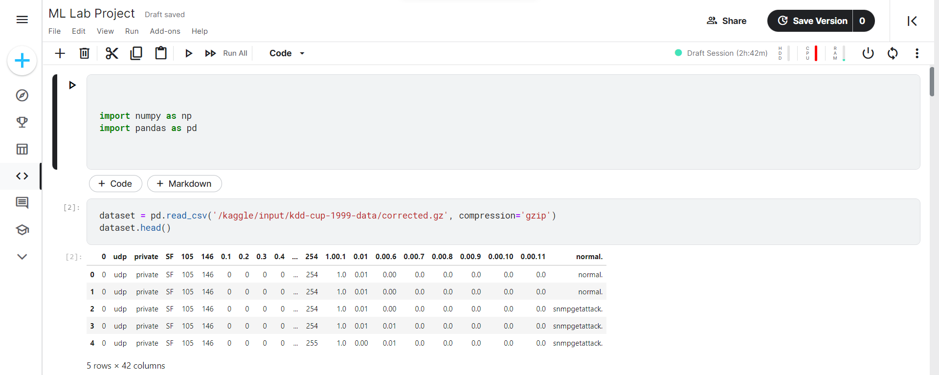
Importing the Dataset

Slide 5
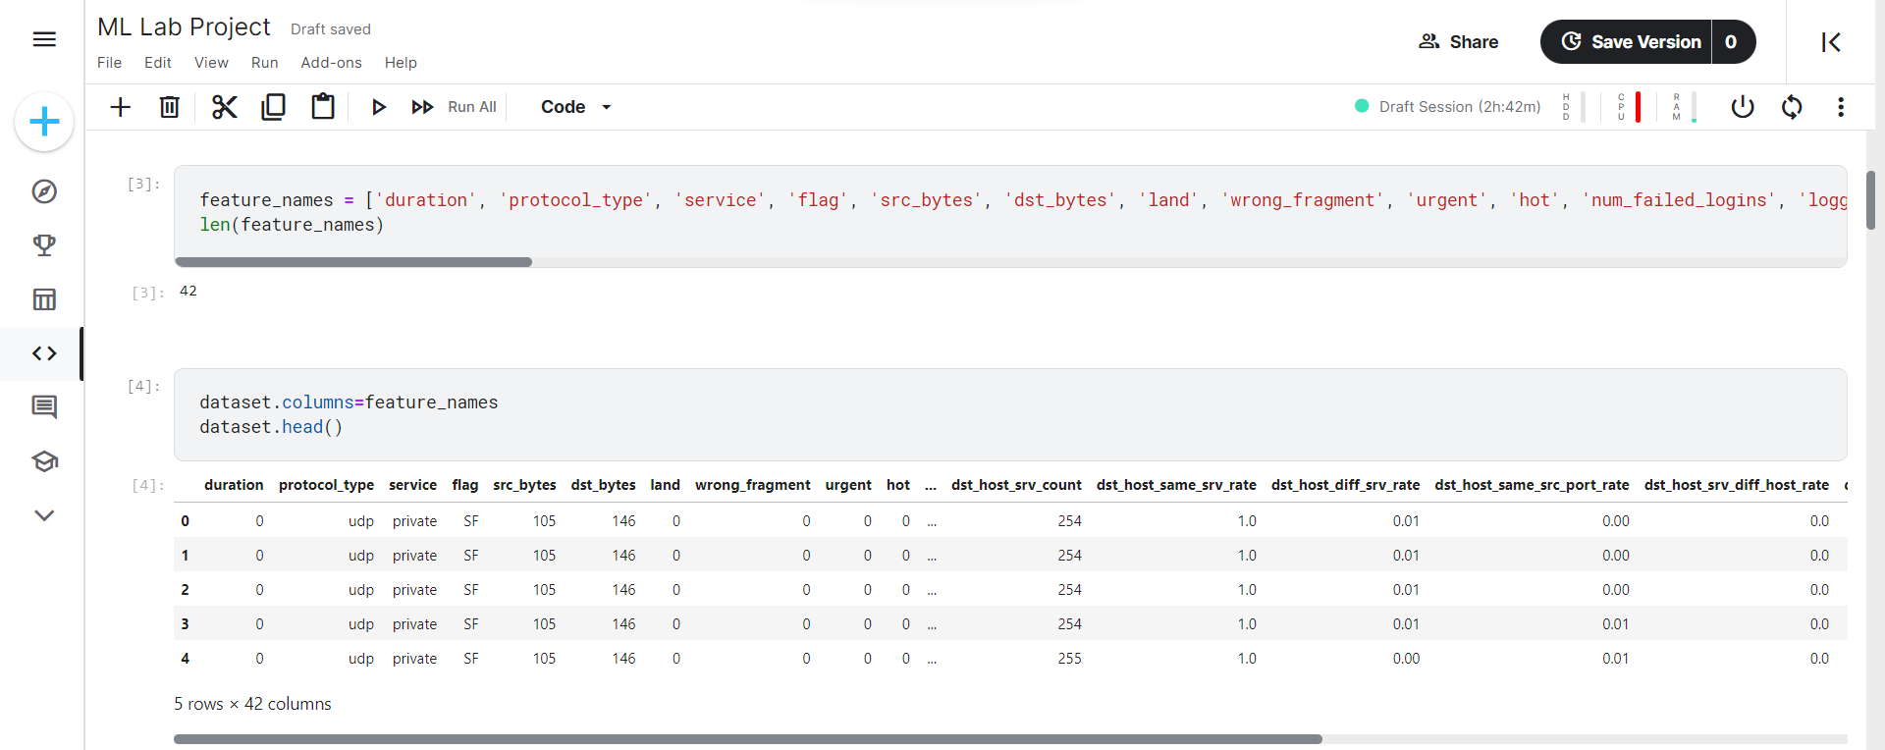
Adding the labels

Slide 6
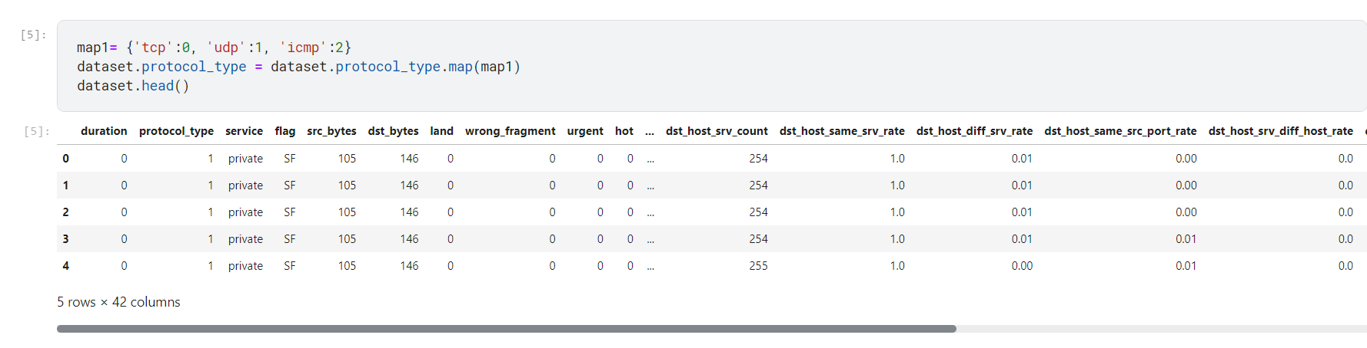
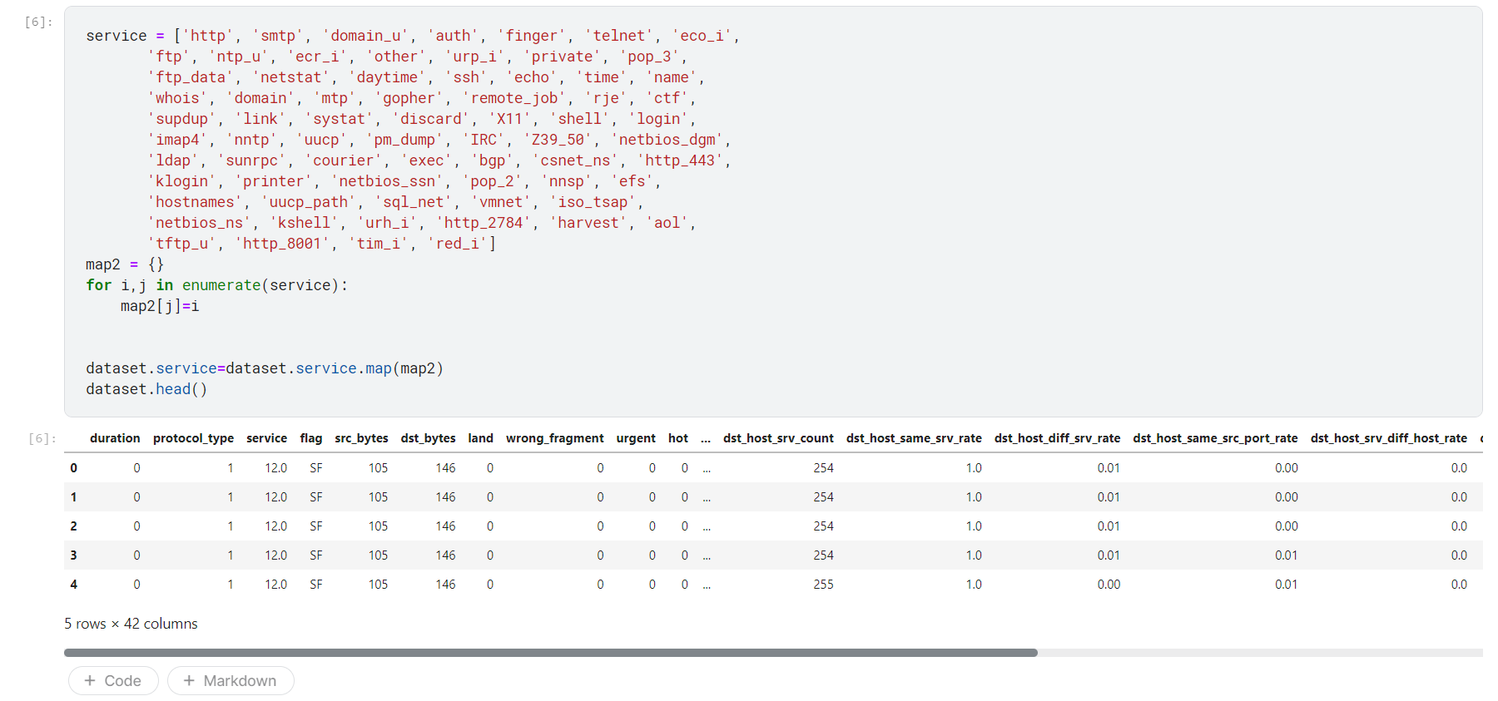
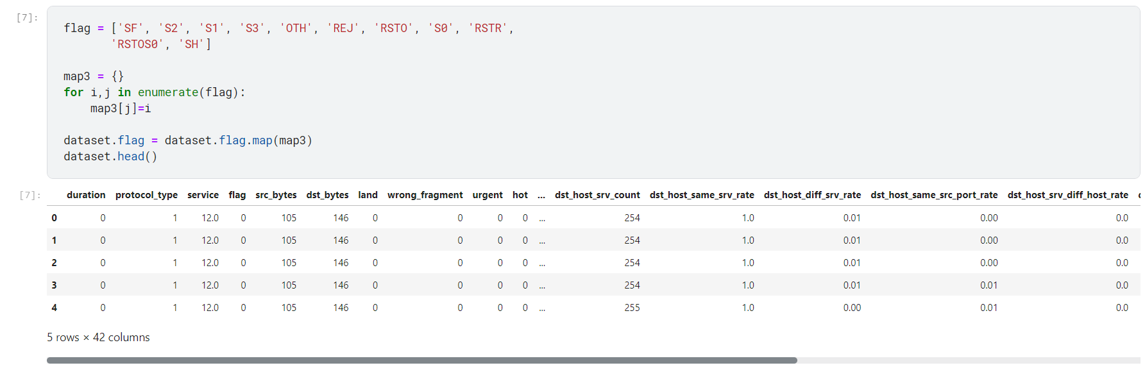
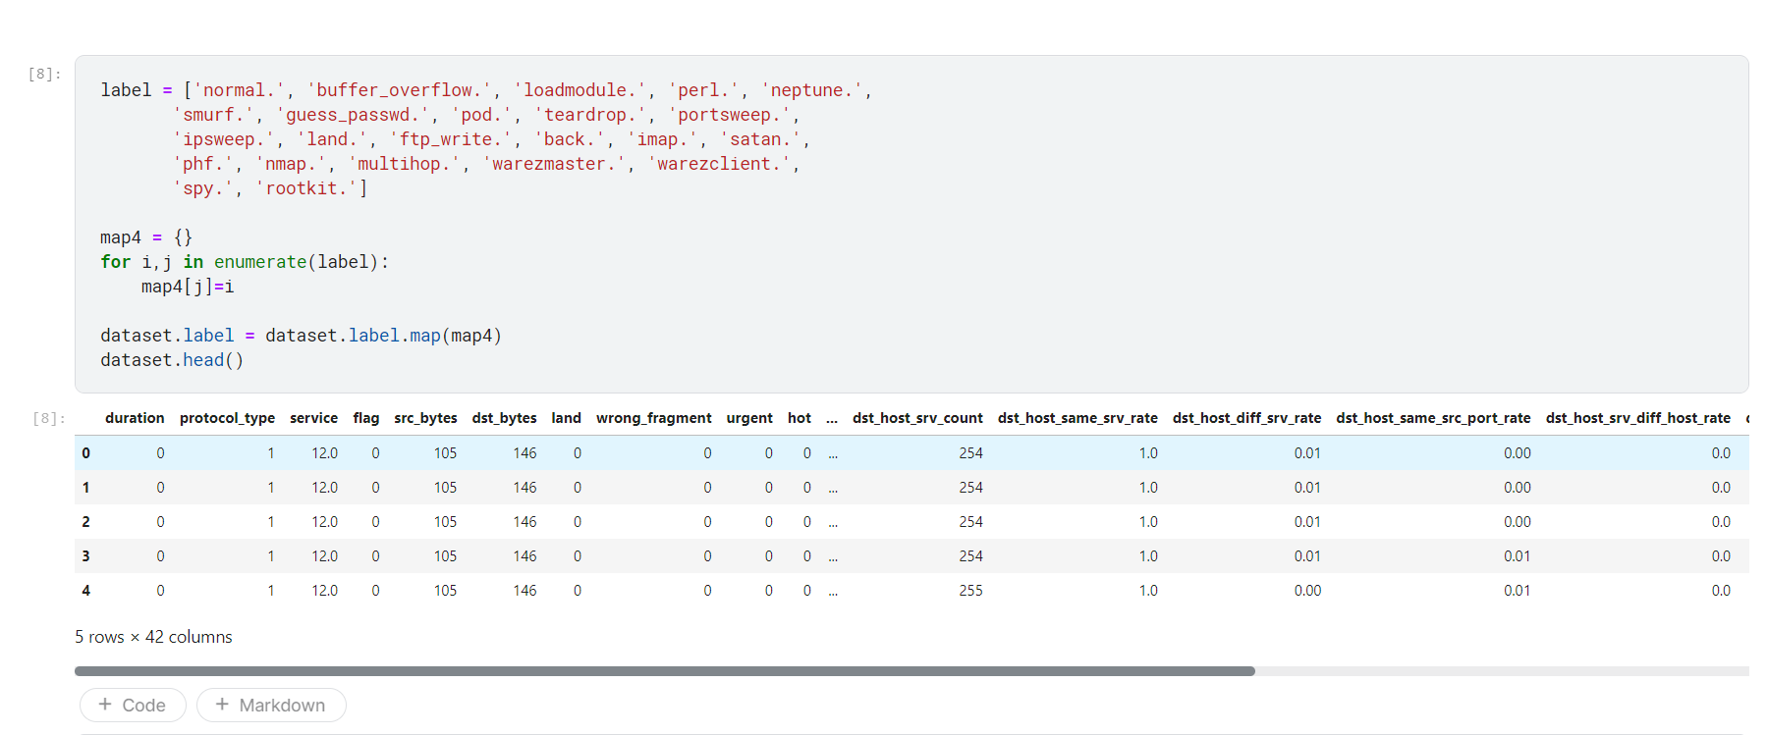
Converting categorical string values to numbers

Slide 7
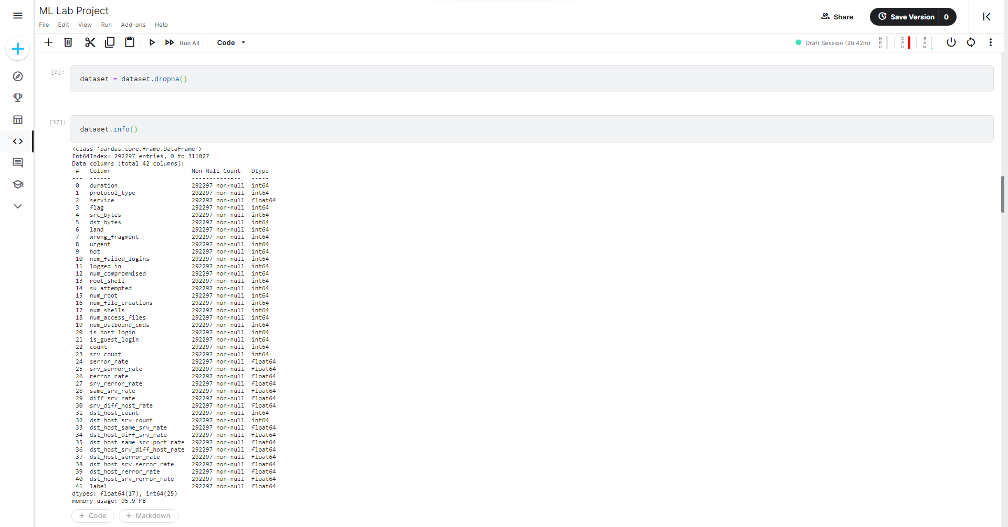
Dropping the null values

Slide 8
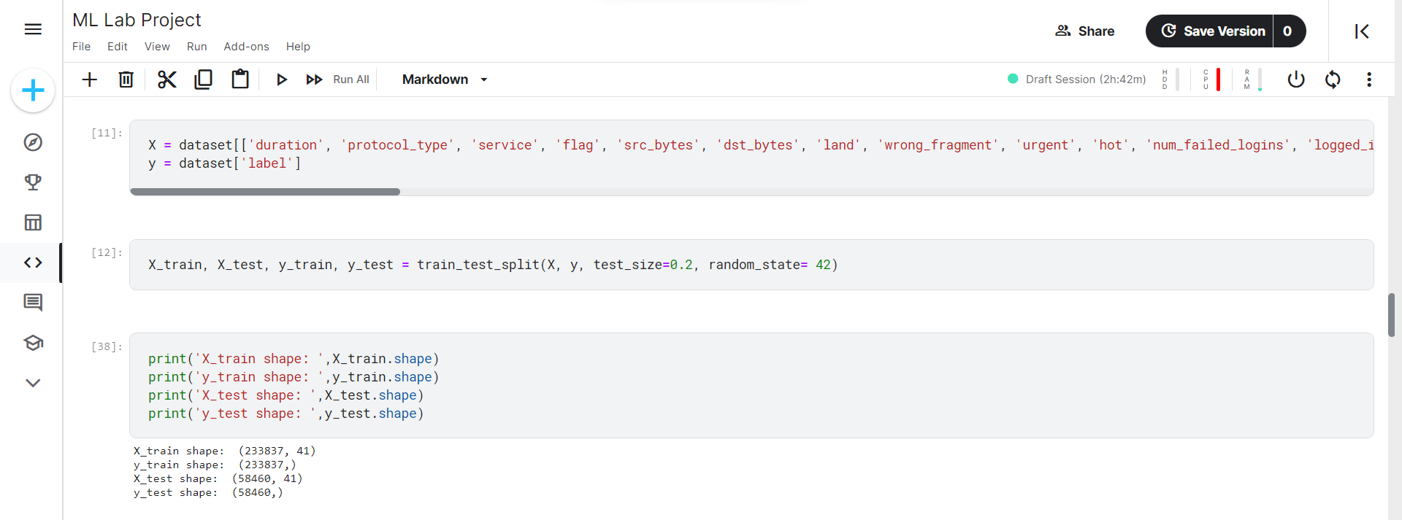
Train – test split

Slide 9
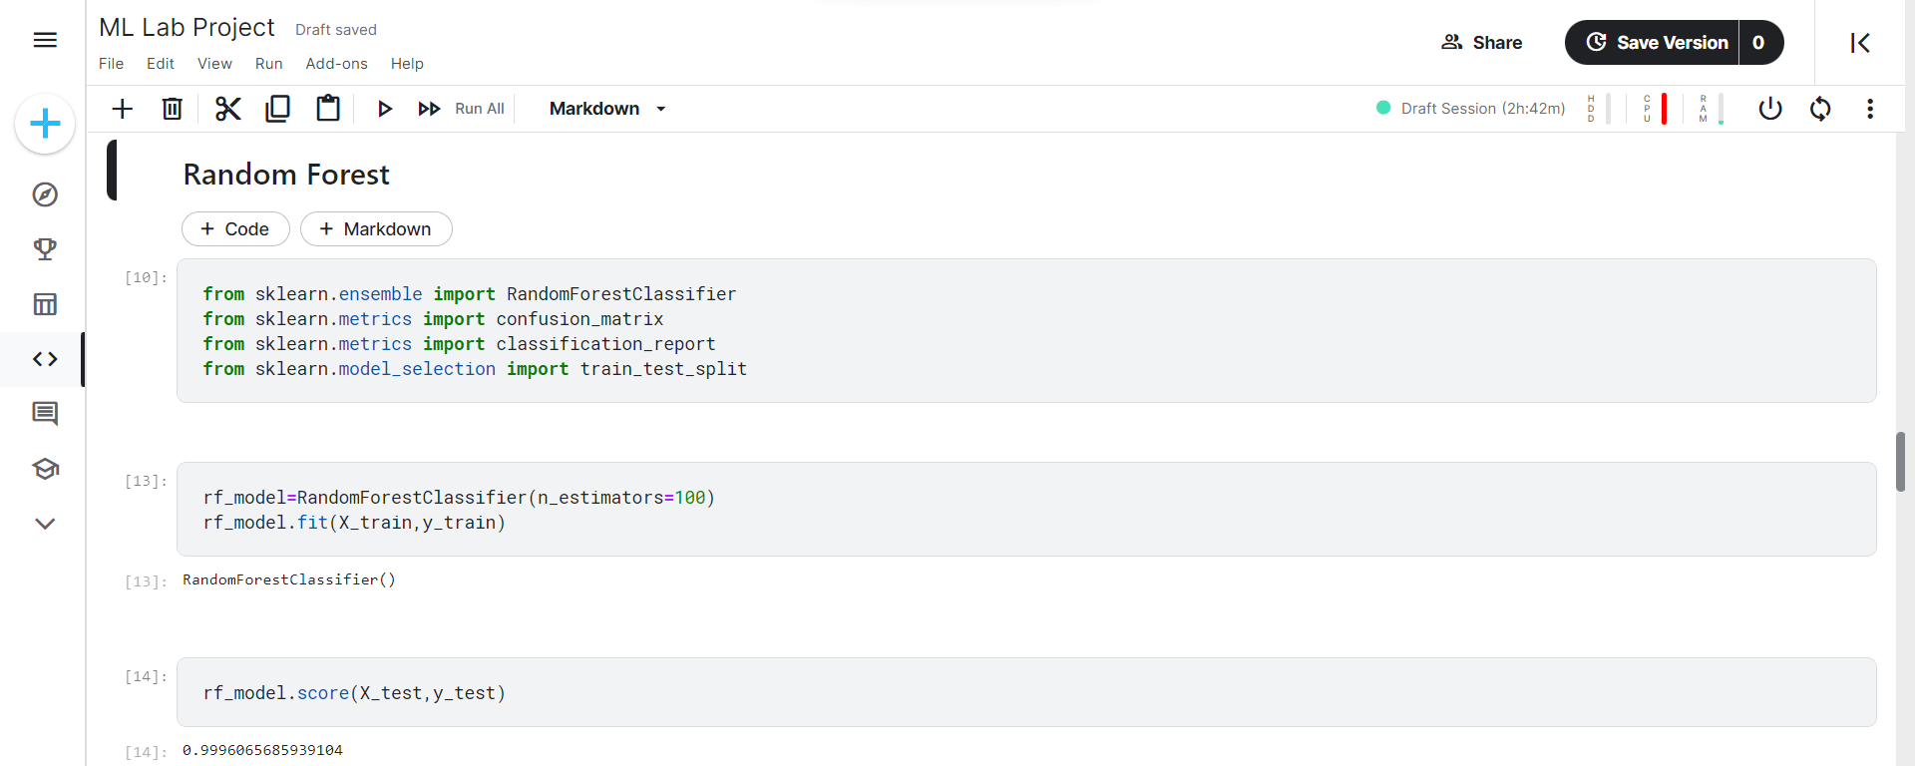
Random Forest Model( with the score)

Slide 10
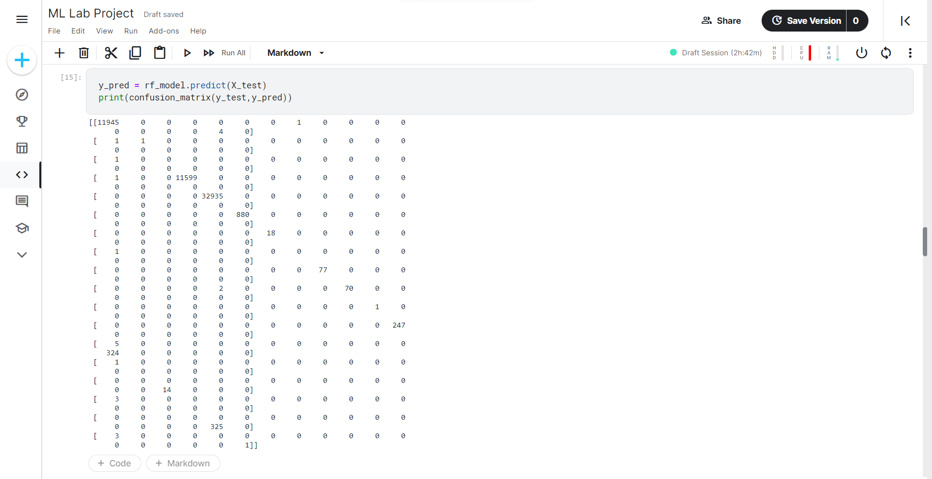
Random Forest Confusion Matrix

Slide 11
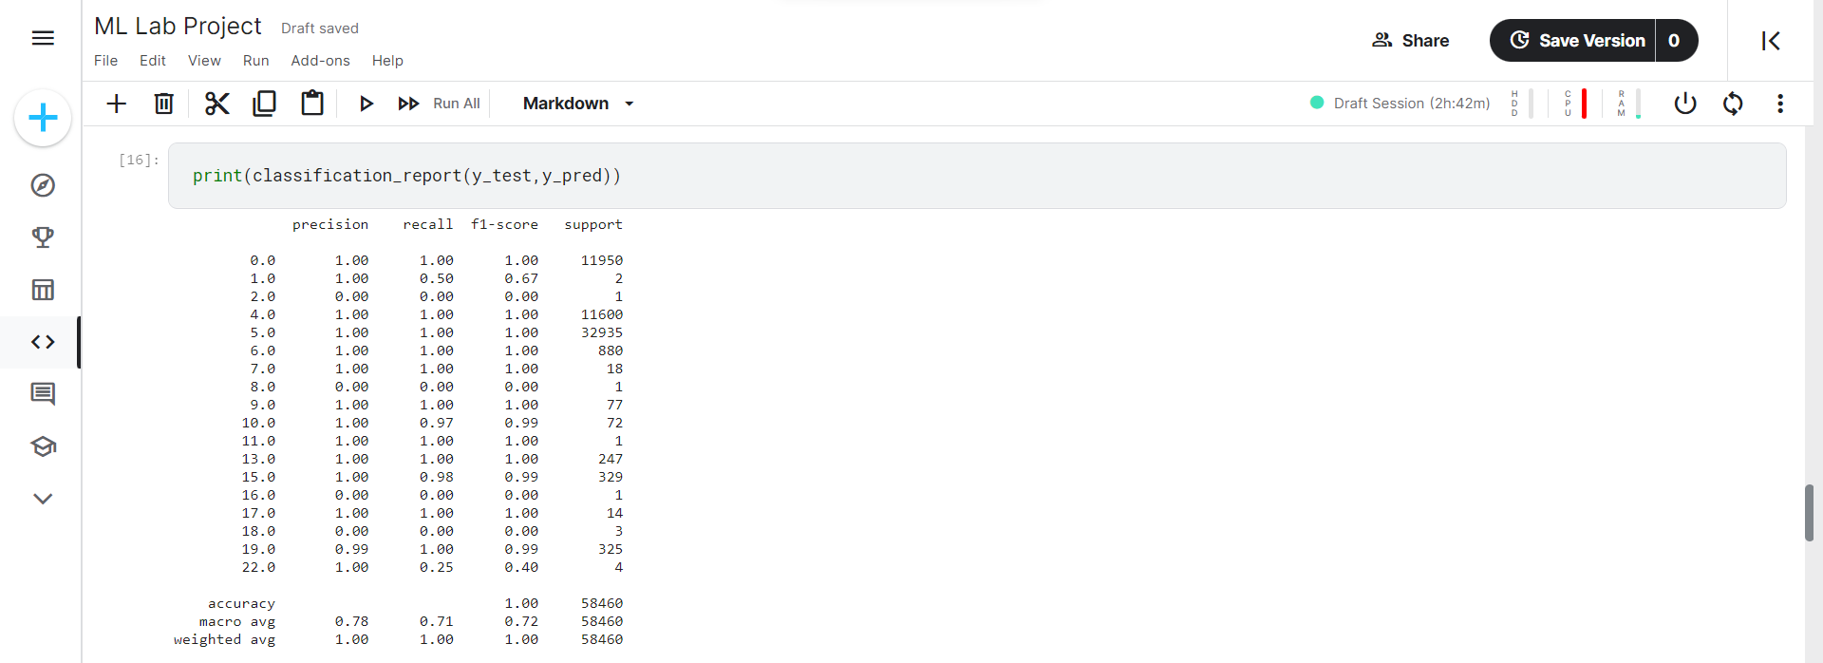
Random Forest(Classification Report)

Slide 12
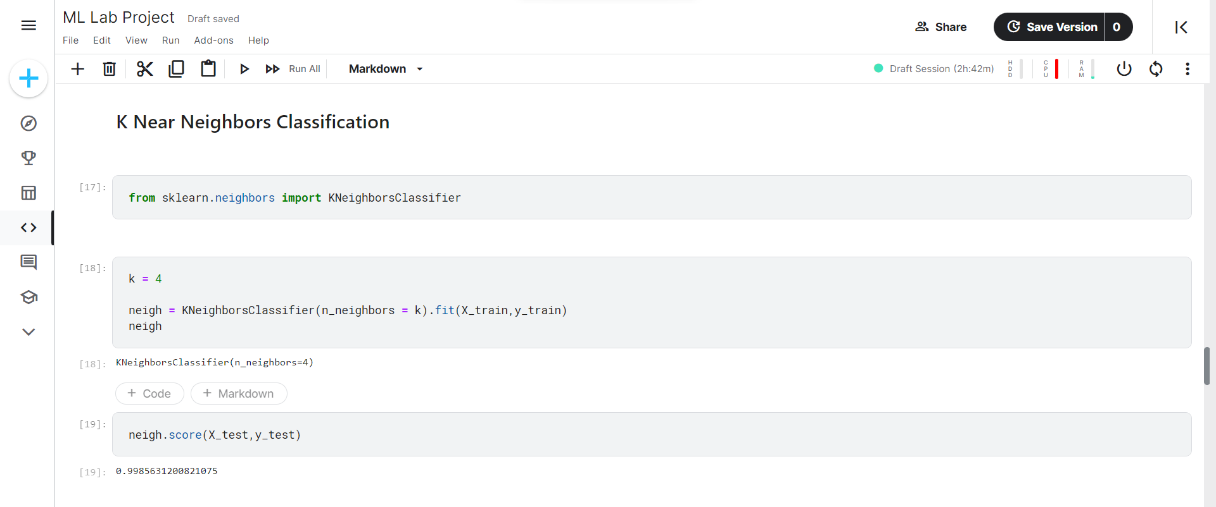
K Nearest Neighbours(with score)

Slide 13
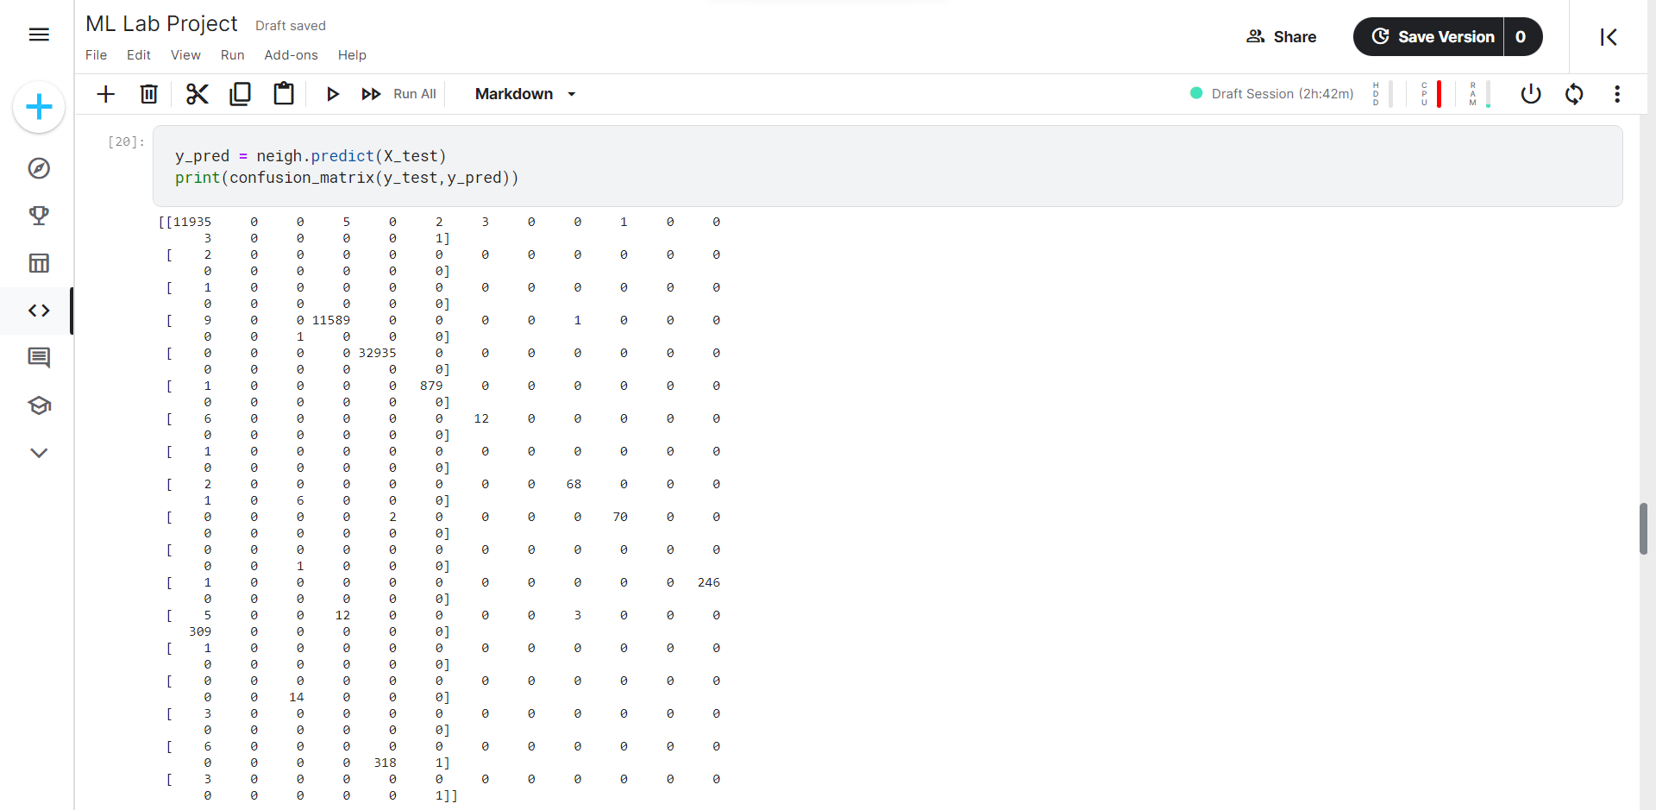
K Nearest Neighbours Confusion Matrix

Slide 14
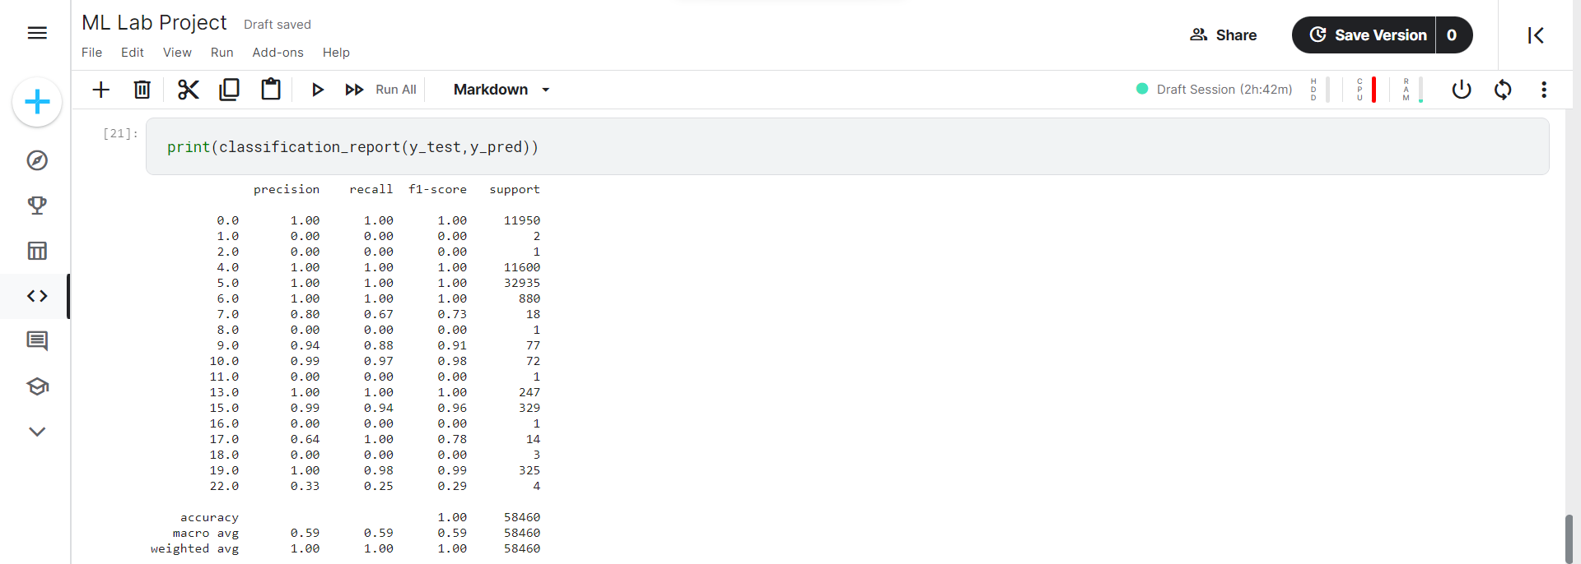
K Nearest Neighbours Classification Report

Slide 15
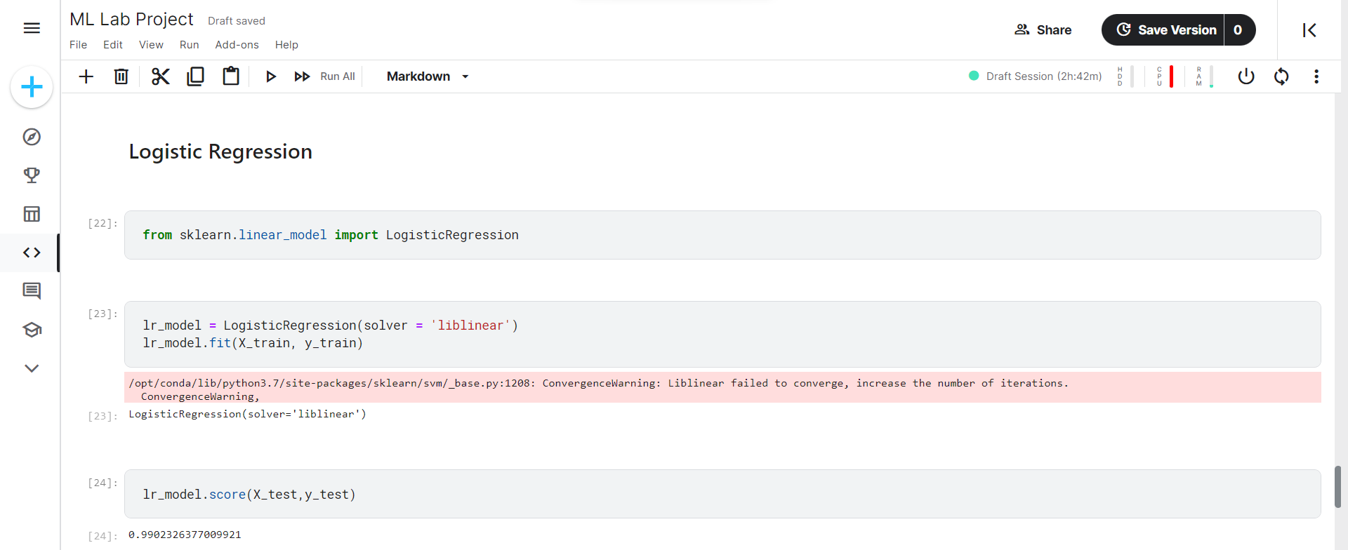
Logistic Regression(with score)

Slide 16
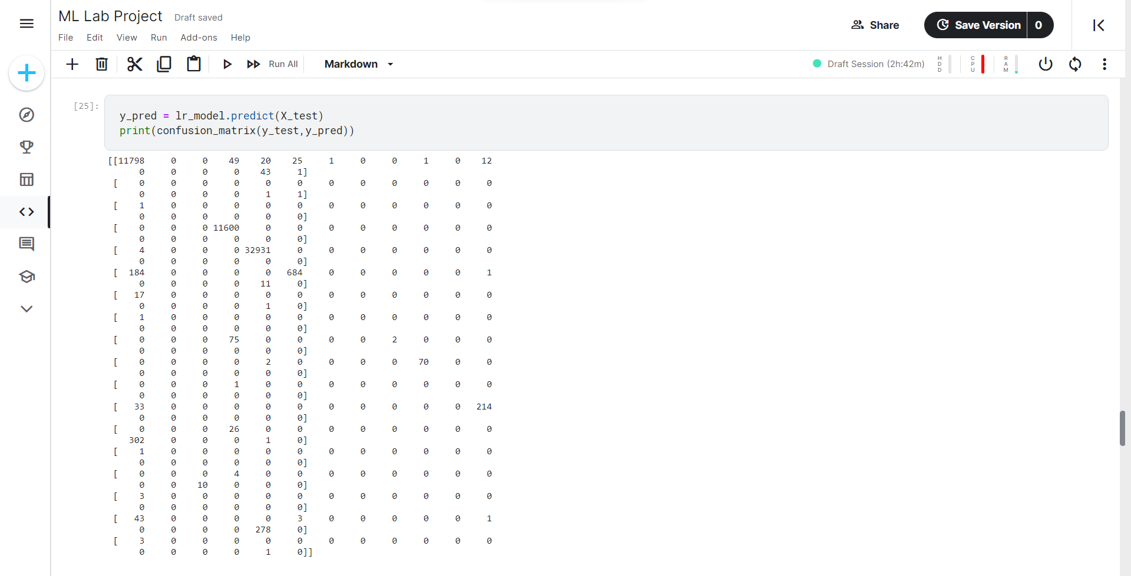
Logistic Regression Confusion Matrix

Slide 17
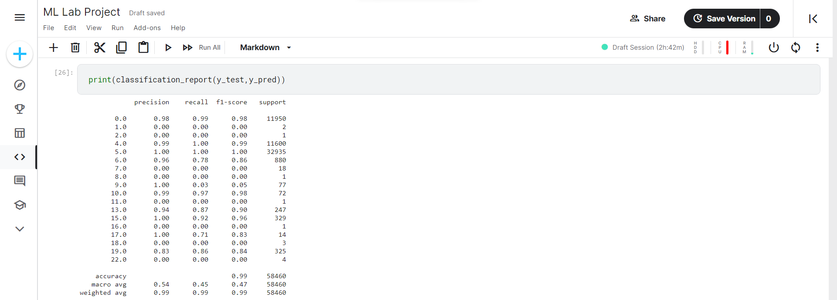
Logistic Regression Classification Report

Slide 18
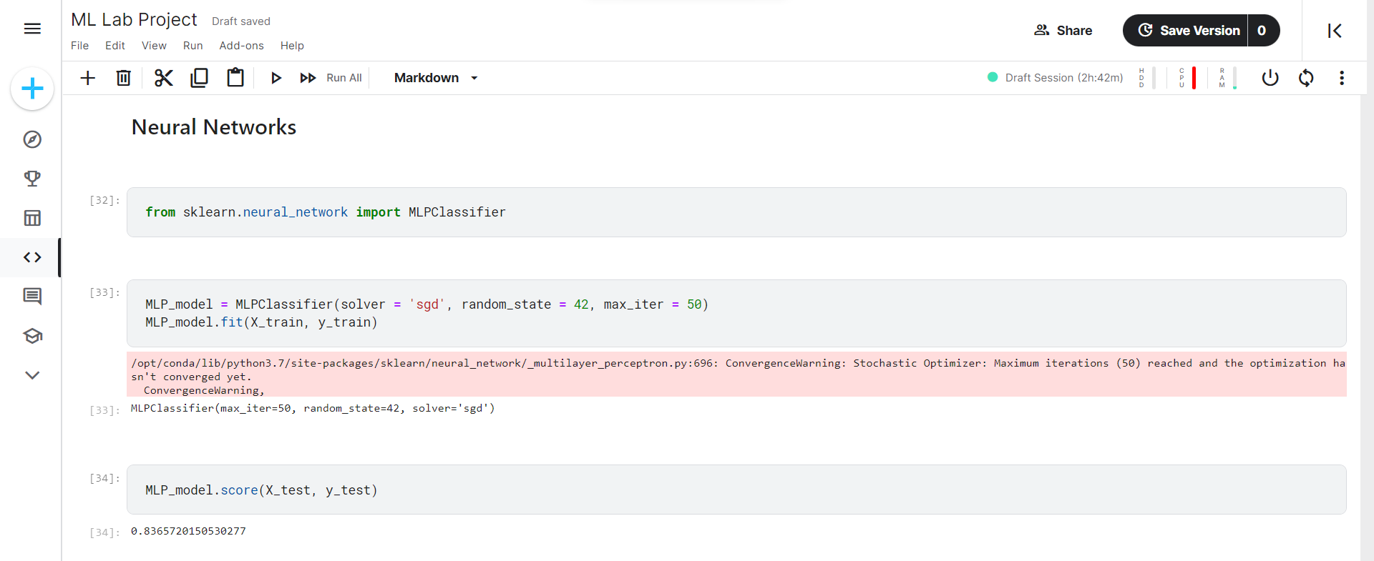
Neural Networks- MLPClassifier(with score)

Slide 19
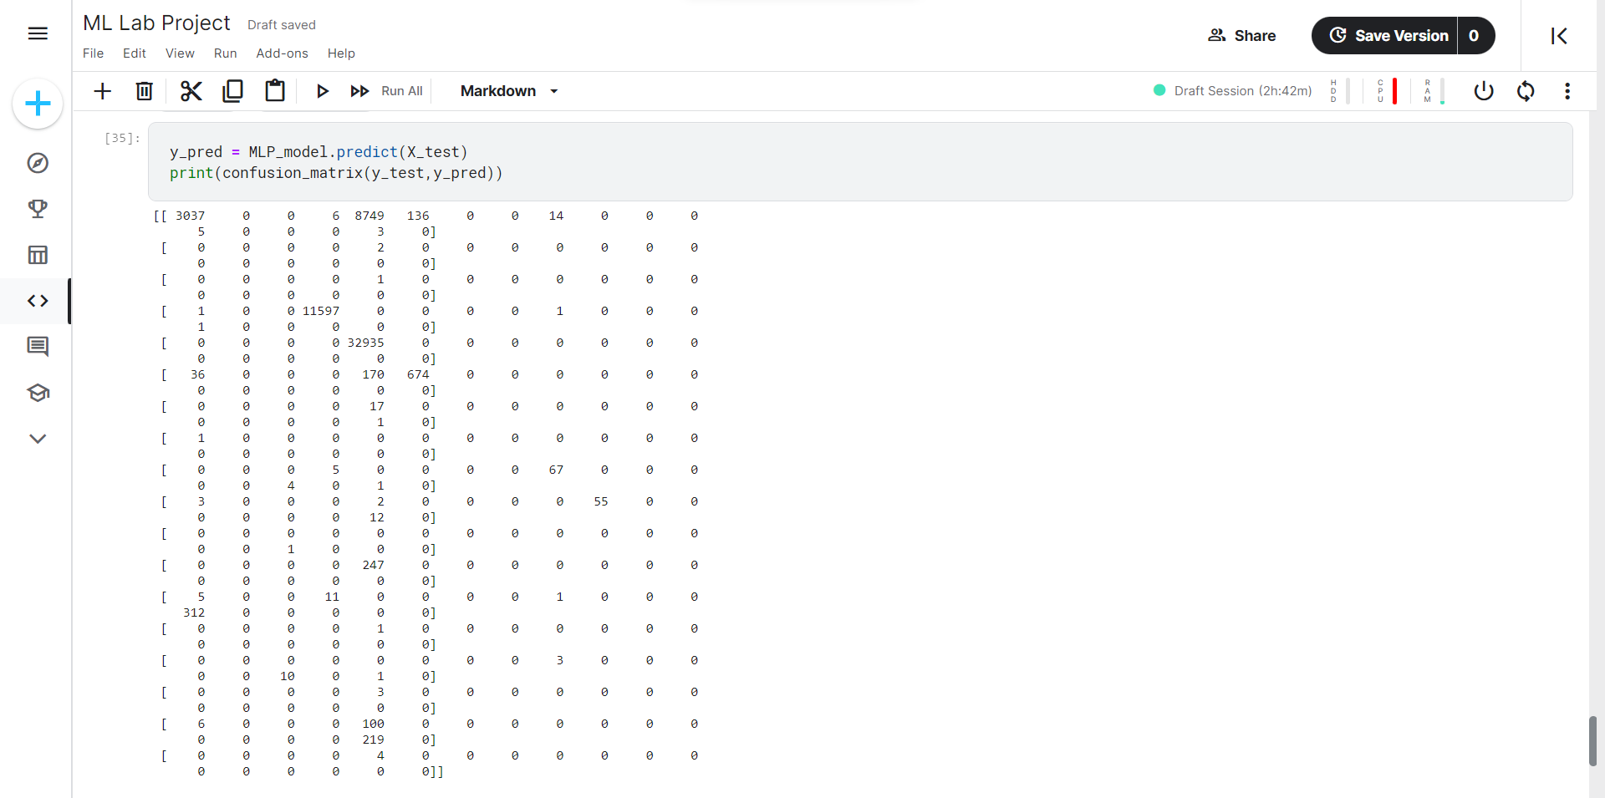
MLP Classifier Confusion Matrix

Slide 20
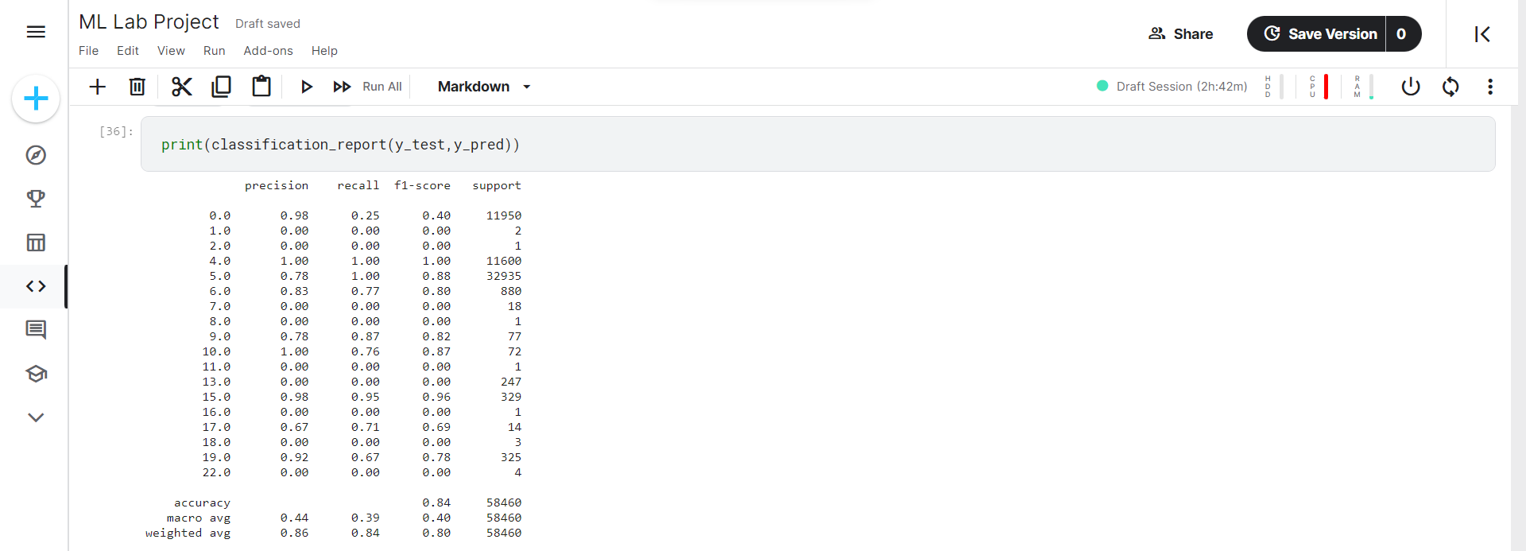
MLP Classifier Classification Report

Slide 21
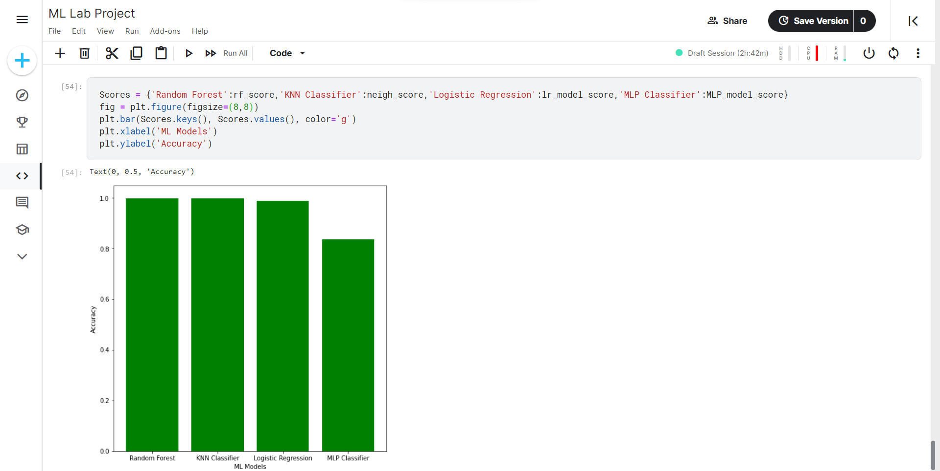
Final Comparison of Accuracies

Slide 22


